Slide 1
HUNTABLE Scenarios
Mrudula Jannumahanthi

Slide 2
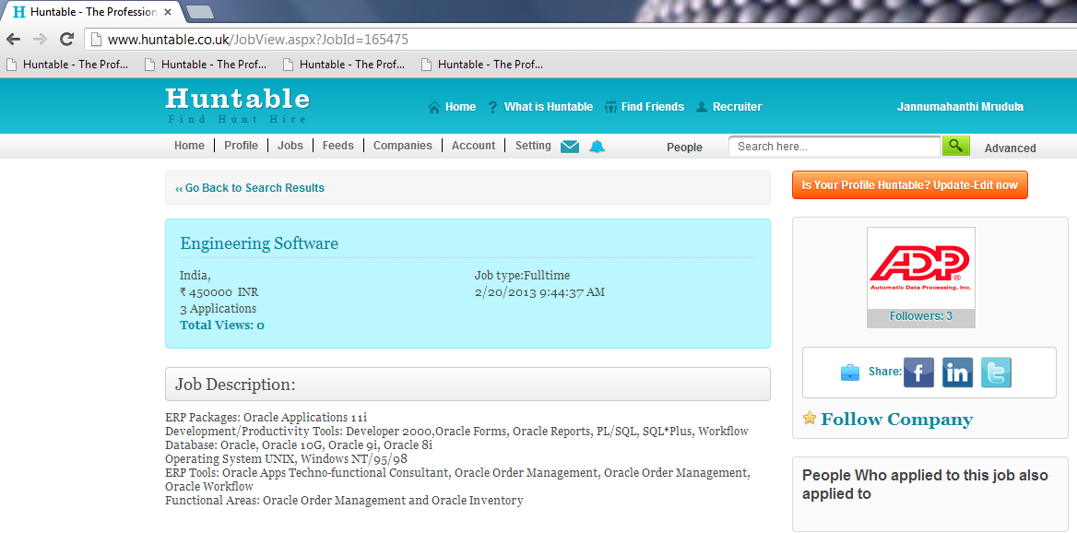
1 URL FOR JOBS POSTED IN HUNTABLE AND PULLED FROM RSS FEEDS
The URL should contain details about the
JOB TITLE, COMPANY NAME & LOCATION
Notes:
Job title
Company name
Location
Salary

Slide 3
URL FORMAT
http://www.huntable.co.uk/jobs/Jobtitle-companyname-location-salary-refnumber
Eg URL:
actual job link in huntable : http://huntable.co.uk/JobView.aspx?JobId=188490
Expected url: https://huntable.co.uk/jobs/associate-software-engineer-IBM-Bangalure-rs360000-188490

Slide 4
URLs from different sites
http://www.caterer.com/JobSeeking/Fine-Dining-Chef-De-Partie-Aylesbury-upto-18000-Plus-Tips-and-Live-I_job55888187
http://www.shine.com/jobs/engineer-software/slk-software-services-private-limited/753768/
http://hyderabad.timesjobs.com/job-detail/Human-Resource-IR-Training-Development-job-in-Universal-Jobs-Hyderabad-Secunderabad-jobid-Xl+8L0Bl40NzpSvf+uAgZw==-key-human%20resource-loc-198265
http://jobsearch.naukri.com/job-listings-Quality-Analysts-Testers-manual-Testing--Allstate-Solutions-Private-Limited-Bengaluru-Bangalore-1-to-5-110313002449?xz=1_0_69&xo=&xp=2&xid=136308390337003700&qjt=&qp=manual+testing&id=&f=-110313002449
http://jobs.taaza.com/detail/1995858
http://www.reed.co.uk/jobs/sous-chef-busy-hotel-thame-ox9-20kbenefits/22691210#/jobs/hospitality-catering/sous-chef/aylesbury
http://www.totaljobs.com/JobSearch/JobDetails.aspx?JobId=56010743&Keywords=&Industry=3

Slide 5
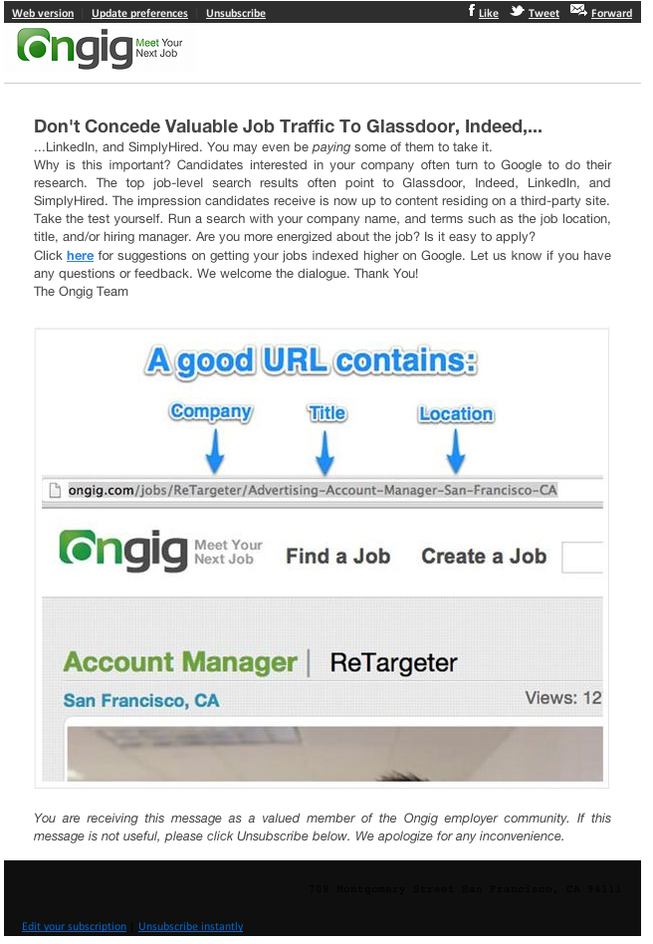
Example For the listed URLs

Slide 6
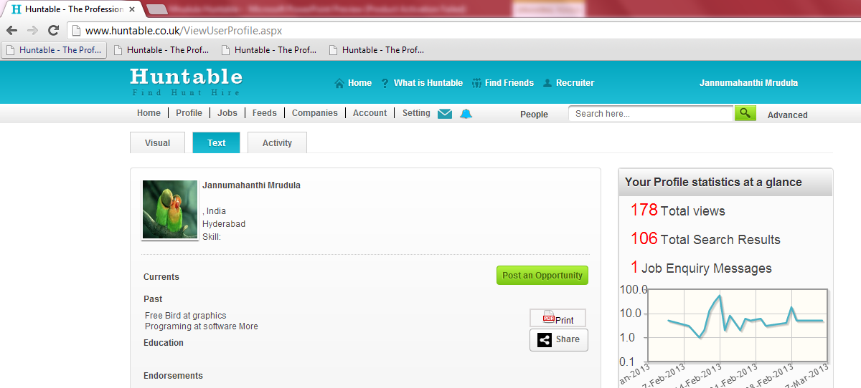
User - Once user gets registered - user to have these in their URL - Name, both first & last name, job title , location
The URL should contain details about the
BOTH FIRST & LAST NAME, JOB TITLE and LOCATION
Notes:
All the three things Visual CV
Text CV
Activity

Slide 7
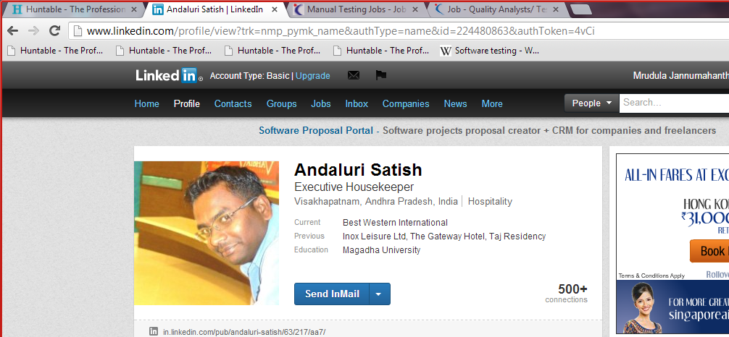
The URL with in the website

Slide 8
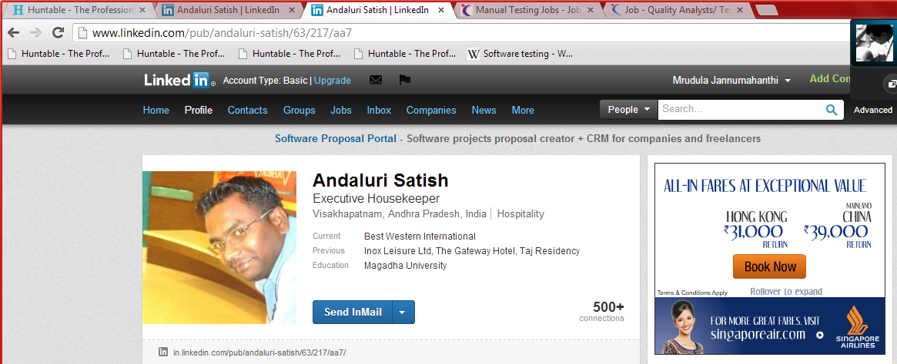
The URL when searched in google

Slide 9
USERS Url’s
Will update with more details soon

Slide 10
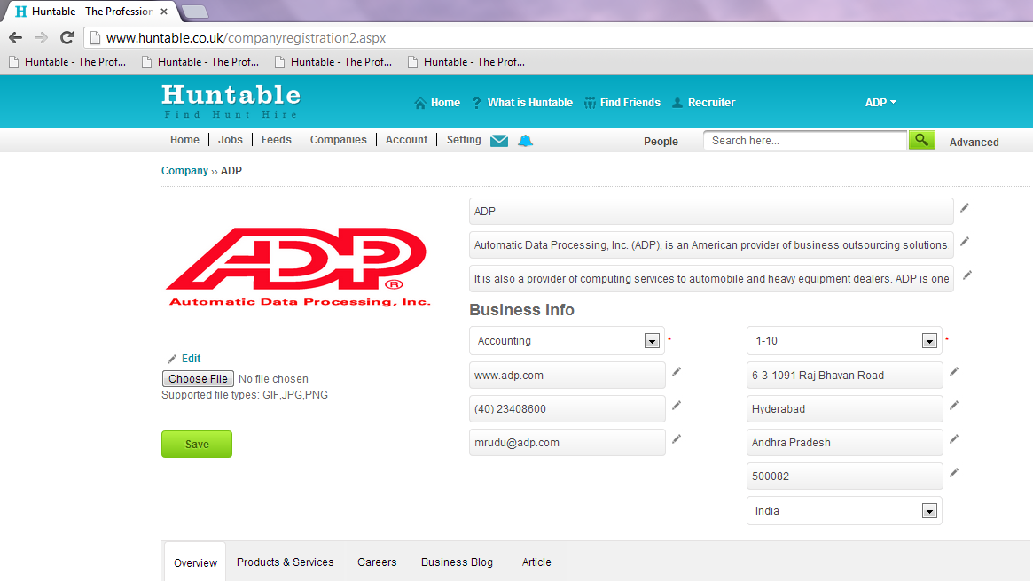
Company – companies registered to have THE URL as - company name, location
The URL should contain details about the
COMPANY NAME, LOCATION

Slide 11
URL FORMAT:
http://www.huntable.co.uk/companies/companyname-location-industry-refnumber
Eg:
Actual company link in Huntable:
http://huntable.co.uk/companyview.aspx?Id=77
Expected URL:
https://www.huntable.co.uk/companies/IBM-International-Business-Machines-bangalore-computer-software-id887652
Reference number is generated by Huntable.

Slide 12
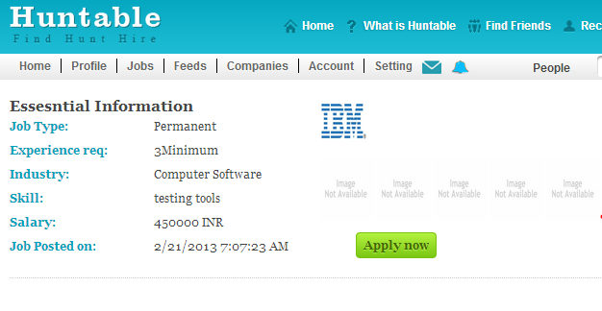
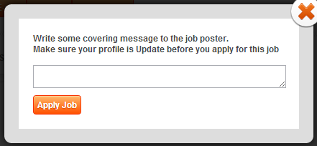
2 When a user applies for a job, we need to display a pop up , so that the Applicant can make a comment or write a note about them. This detail will be also shown in the email received by the Job poster
DEFAULT MESSAGE TO BE DISPLAYED
Hi,
My name is “First name – surname “ I would like to apply for the job posted by you. Please check my profile, achievements, portfolio & endorsements for more details.
Look forward to hear from you.
Regards
First Name
The text box should have enough space that the total message should be displayed.
sample design in this link –
http://gates.cc/works/huntable/html/profile.php
click on Apply for Job - at the bottom to see the pop up
In the following pages.
Oppertunities: http://huntable.co.uk/HomePageAfterLoggingIn.aspx
http://huntable.co.uk/JobsearchTips.aspx
http://www.huntable.co.uk/JobView.aspx
http://www.huntable.co.uk/companyjobs.aspx

Slide 13
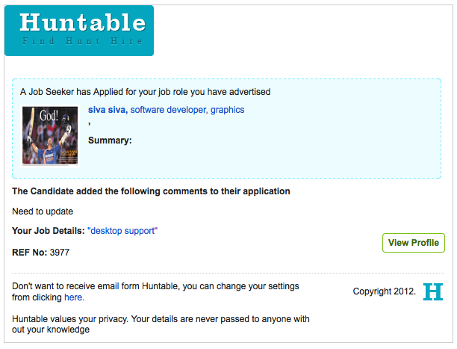
Email TEMPLATE
In Job post page insert a field JOB REFERENCE
NUMBER and
it should be non-mandatory.
Display reference number in the email template.
Reference number can be anything – just numbers
Or a combination of numbers and letters.
Two or more companies can have the same reference number
i.e, the same reference number can be used by any number
Of users/companies.
Any message typed in the pop-up should be made visible to the job poster in his email. If the user does not enter any text default message should be visible.
If its our database ref no, then we need to change this.

Slide 14
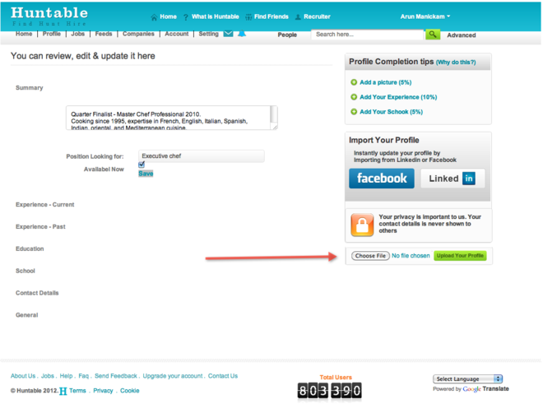
3 In the edit profile - Add an option to upload profile by word document as in profile Upload page under Facebook / LinkedIn.

Slide 15
PROFILE UPLOAD IN EDIT PROFILE
If the profile completeness of the user <60% then display the upload file function tab
If more than 60% then file upload function should NOT be visible

Slide 16
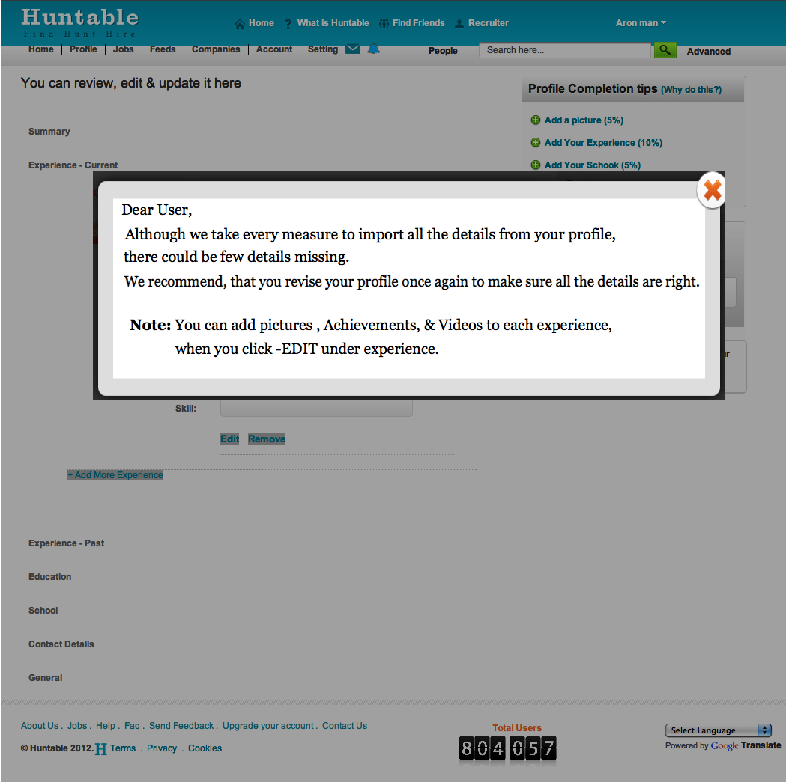
4 Pop up - after uploading profile from LinkedIn- Facebook, Word / PDF document - to display before showing the edit profile page.
As we cant import all profiles exactly the way it is in either LinkedIn, Facebook, or word / pdf document, Can we add a small pop up as soon as they uploaded, and before they see their edit profile.
This pop up explains, to the user, that there might be some mistakes and they need to check to make sure all the details are right.

Slide 17
PAGES where pop-up need to be added
http://huntable.co.uk/ProfileUploadPage.aspx
http://huntable.co.uk/EditProfilePage.aspx

Slide 18
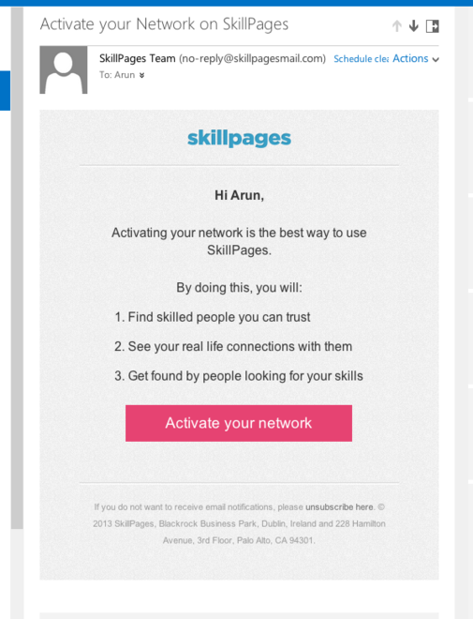
5 Automatic sending Invitations - To Friends from email accounts & Social accounts
(i) We must send an email alert after 5 days of registering in Huntable.
(ii) When clicked on Activate my network Automatically pull contact details from the user and send invitations automatically

Slide 19
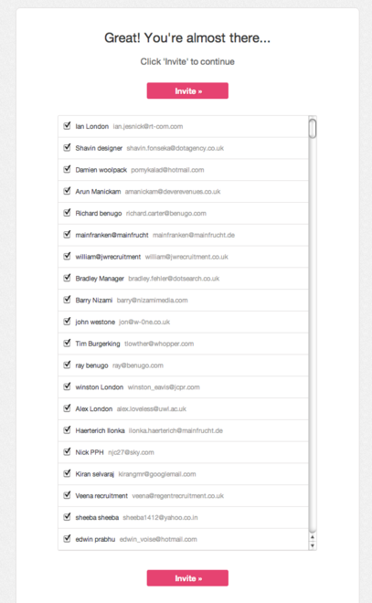
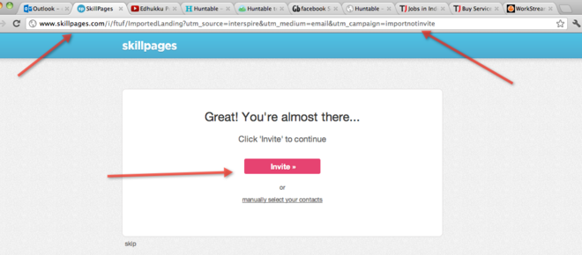
Automatic sending Invitations - To Friends from email accounts & Social accounts
If we are unable to send invitations automatically On Clicking in the email, takes to a page, where all the email contacts are automatically updated to send an invitation.
On clicking Invite we should open another page in which we can select and deselect the contacts for invitation. ALL THE CONTACTS PULLED SHOULD BE SELECTED BY DEFAULT.

Slide 20
6(a) SOME activity in Huntable should be automatically shared in Facebook a/c of the user This should be performed by the Huntable facebook application. It should be displayed like shared via Huntable
Users:
User follows another user.
User follows a company.
User posts a job.
If user gets endorsed by Company
If user gets endorsed by another User.
If user posts a link in Huntable the feed should be shared in the facebook → When clicked on the shared message it should be redirected to the post that is actually shared in Huntable.
When user updates the following:
Edit Profile → Experience Current.
Edit Profile → Experience Past.
Edit Profile → Experience → Add Achievements.
Edit Profile → Experience → Add Portfolio.
Edit Profile → Experience → Add Videos.
Updated Education
Updated School
Updated Interests
Updated Skills
User likes a companies profile.
User likes another users profile.

Slide 21
6(b) SOME activity in Huntable should be automatically shared in Facebook a/c of the company & RECRUITERS This should be performed by the Huntable facebook application. It should be displayed like shared via Huntable
Companies: Recruiters and companies are the same
Company follows a user.
Company follows another company.
Company posts a job.
Company updates the following:
Portfolio.
Products and services.
Articles.
Adds video.
Adds pictures.
Company comments on its job feeds after posting a job.
If company posts a link in Huntable the feed should be shared in the facebook → When clicked on the shared message it should be redirected to the post that is actually shared in Huntable.
Company likes another company profile.
Company like users profile

Slide 22
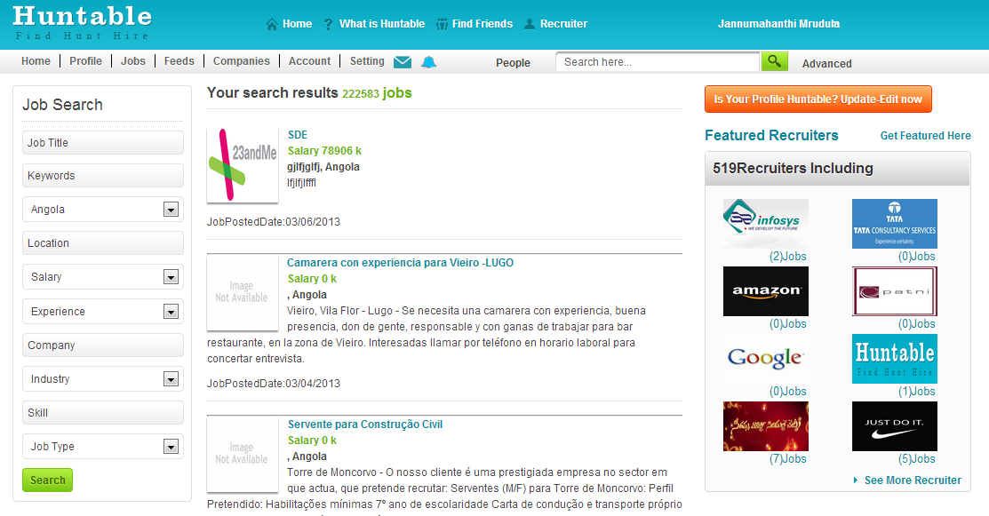
7 Adapters for the country search needs TO be done.
All the RSS jobs need to be able to be searched by Country & Location

Slide 23
8 Customize feeds - In the industry, skill, interest & country - once the user selects anything in the boxes, when they go to other tab without saving, alert to be shown - WOULD YOU LIKE TO SAVE YOUR PREFERENCES
Would you like to save your preferences
Save Cancel
http://huntable.co.uk/CustomizeJobsSalary.aspx
http://huntable.co.uk/CustomizeJobsIndustry.aspx
http://huntable.co.uk/CustomizeJobsSkill.aspx
http://huntable.co.uk/CustomizeJobsJobType.aspx
http://huntable.co.uk/CustomizeJobsCountry.aspx
http://huntable.co.uk/Customize-User.aspx
http://huntable.co.uk/CustomizeFeedsIndustry.aspx
http://huntable.co.uk/CustomizeFeedsSkill.aspx
http://huntable.co.uk/CustomizeFeedsInterest.aspx
http://huntable.co.uk/CustomizeFeedsCountry.aspx

Slide 24
9 Automatic invoice to be created & sent by email and available in my accounts after any purchase.
1. Email to be sent to the user
2. Should be also able to see in their Account section.

Slide 25
10 Alert bell notifications. All the Notification sent to the Alert bell.
1. Clicking on the alert icon, will list all the notifications as a drop down menu.
2. Clicking on a individual notification, will open the feed in a separate page with, all the feeds in that feed.
DESIGN WILL BE PROVIDED

Slide 26
11 when a user upgrades to PREMIUM membership - the user will need to be sent a email to confirm the upgrade.
Email Template will be provided for this
This email has to be sent after the user has paid for the premium membership.

Slide 27
12 When user changes the password we need to provide an email confirmation
Just send an email with the new password.
Dear "Name",
You have just changed your password to login to Huntable,
Your new password is : ..........
You can now login with your new password to login to Huntable.
Click here to confirm your new password
Sincerely,
Huntable team
If it is not you who changed the password click here to reset.
Note:
To change the password the user has to confirm by clicking this email.
Only then the new password should be activated.
The new password – user should be able to login only with the new password.

Slide 28
13 Changing a email address - need to send a verification email to confirm to the new email address.
VERIFICATION EMAIL FORMAT will be provided.
User gets a email about the email change
User has to verify in the new email address provided.
Upon verification in the new email address the old email should be deactivated or
The user should be able to login ONLY with new email address.
The password can remain the same(the user can change if they want to).

Slide 29
14 If a user haven't visited the site for 4 weeks or have a profile less than 70% profile completeness, then we will send a reminder email
Need to update
1. How many of his friends joined Huntable since then
2. How many more users joined Huntable since then
3. How many companies have joined Huntable since then
4. How many jobs been posted since then
Are you missing out on these
Complete your profile in one click.
upload Facebook, LinkedIn or word or PDF doc of your profile.
EMAIL TEMPLATE WILL BE PROVIDED.

Slide 30
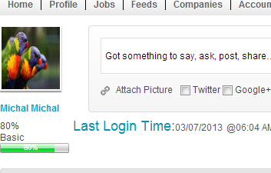
15 When you are viewing other users - clicking on their picture is taking to your picture upload page. This needs to just open the picture or zoom up
http://huntable.co.uk/visualcv.aspx?UserId=462
http://huntable.co.uk/viewuserprofile.aspx?UserId=462
http://huntable.co.uk/VisualCvactivity.aspx?UserId=462#
SAMPLE DESIGN WILL BE PROVIDED.
On clicking this it should
open a new pop-up
with zoomed image

Slide 31
16 Edit profile - option to move the current experience to Past experience in the Current experience section
While the user enters an experience in current and marks it as present then the present experience details should be moved to the experience past section.
SAMPLE DESIGN WILL BE PROVIDED.

Slide 32
17 Networking feed - Hide & Delete a feed. A user should be able to delete his own feed, or hide others feed from showing on their feeds.
Scenarios
A user should be able to delete his own feeds.
A user can hide comments on his feeds made by others.
A comment made by the user on others feeds, he should be able to delete it
SAMPLE DESIGN WILL BE PROVIDED
Pages this should be done:
http://huntable.co.uk/HomePageAfterLoggingin.aspx
http://huntable.co.uk/visualcvactivity.aspx
http://huntable.co.uk/businessactivity.aspx
http://huntable.co.uk/employeeactivity.aspx

Slide 33
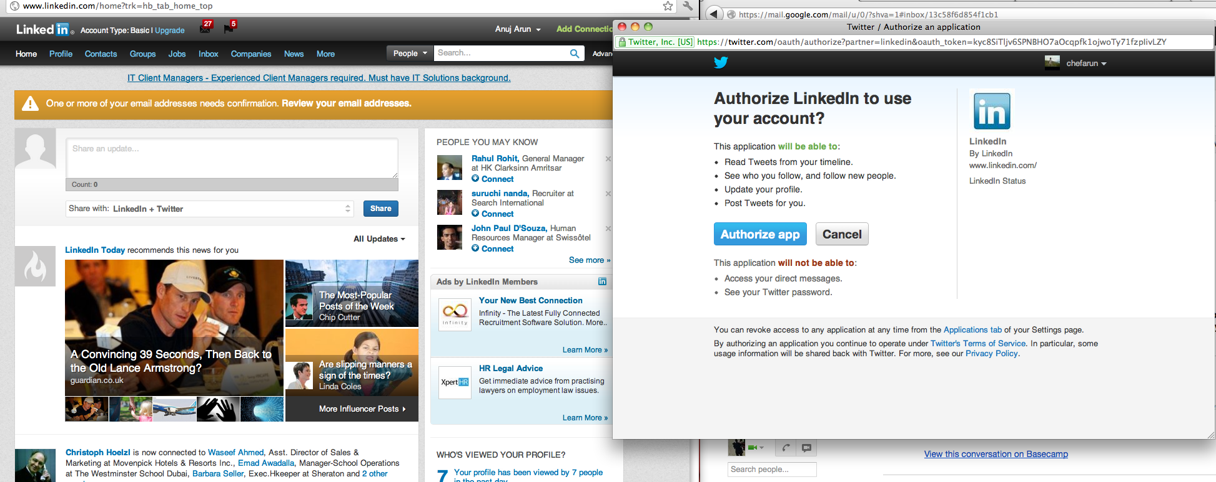
18 Selecting - Twitter, Google+, Facebook, LinkedIn - it is opening a pop up every time. WE should be using the Huntable APP, so the user gives permission only once and not every time they post a feed

Slide 34
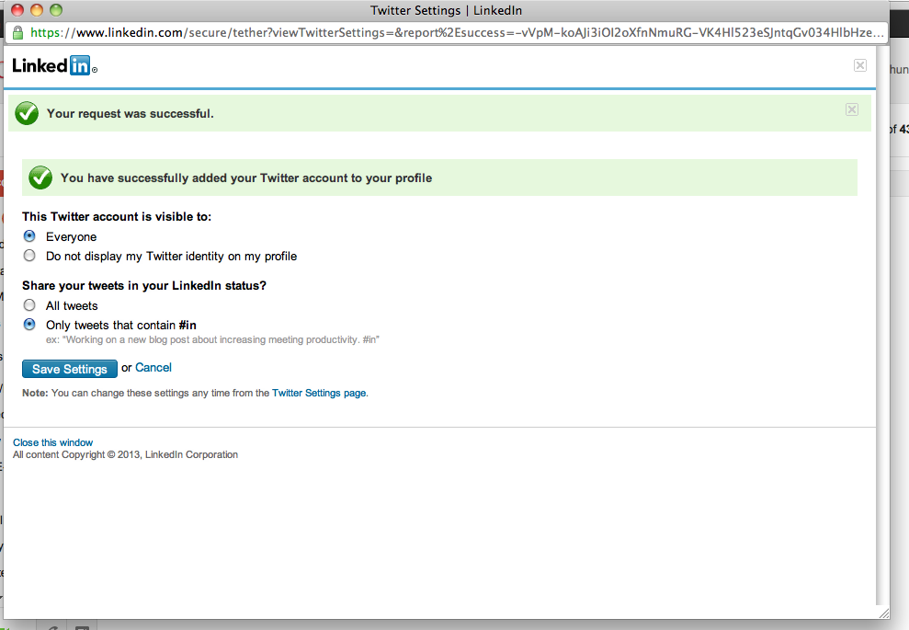
CONT…

Slide 35
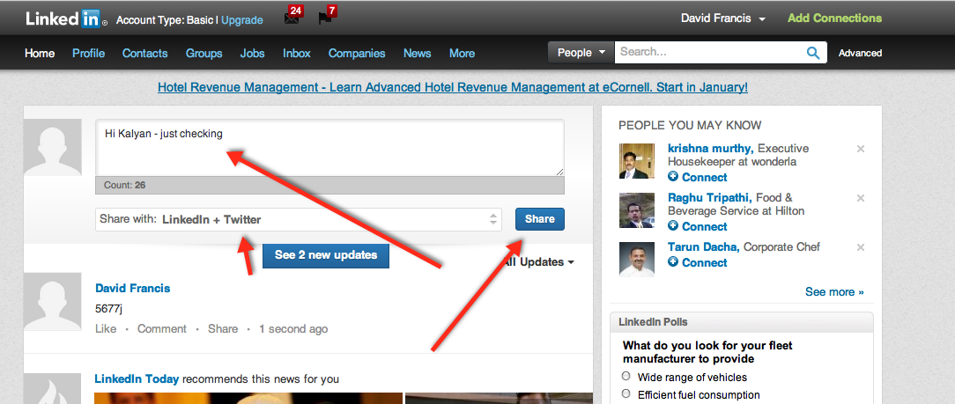
CONT…

Slide 36
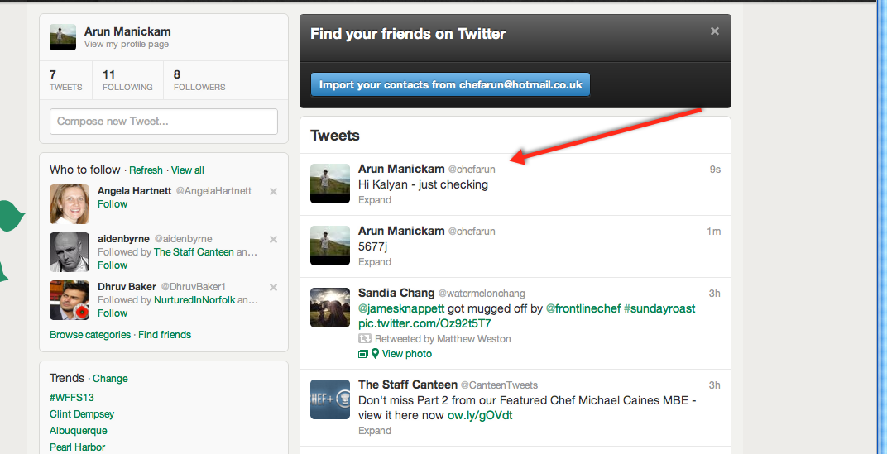
CONT…

Slide 37
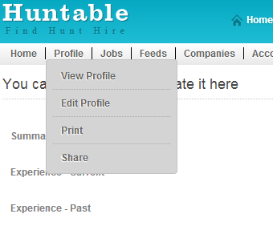
19 Request endorsement to anyone - send request using their email address
DESIGN ISSUE
Insert a tab
Endorsement
After Edit Profile

Slide 38
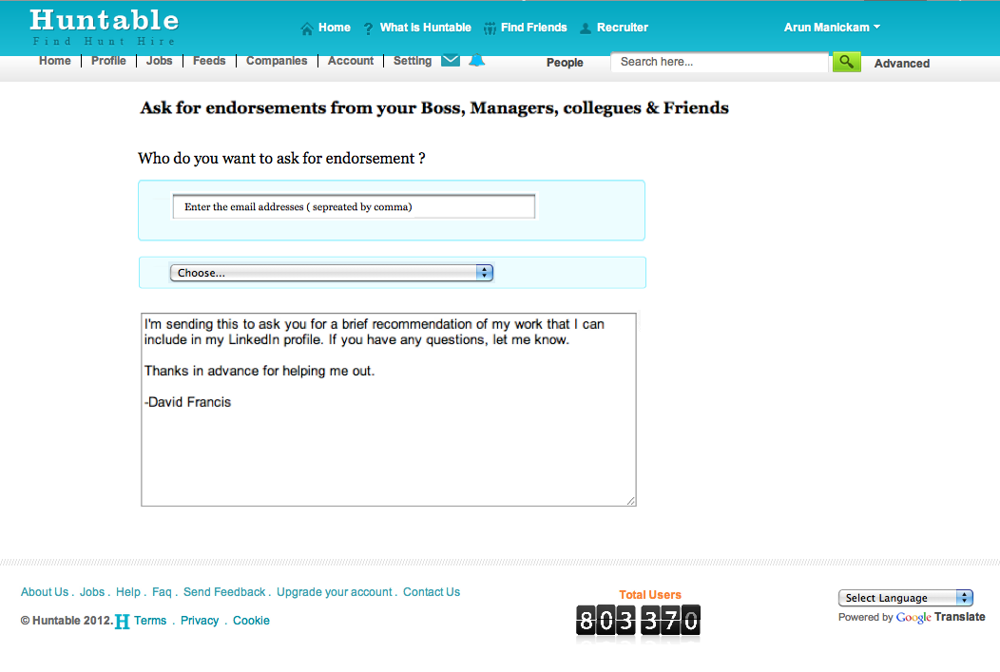
CONT…
This page should be linked to the Endorsement Tab
In the choose tab the companies in user’s experience should be listed.
New URL for endorsement page
Hide endorsements for companies and for recruiters

Slide 39
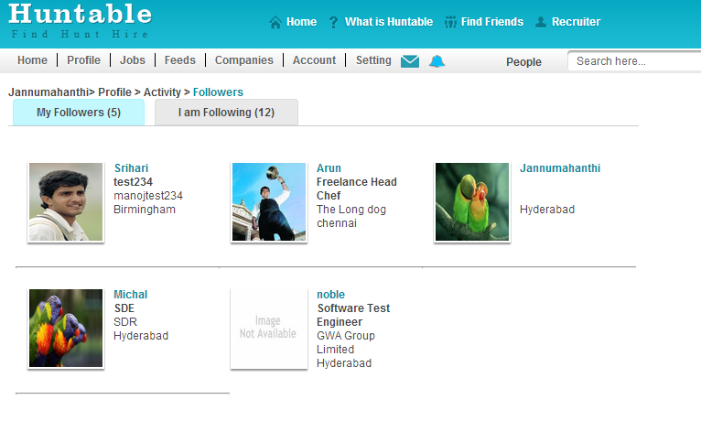
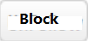
20 Add Block button next to profile picture of the user in Main menu → Accounts → profile → followers
Blocking, will block the user from viewing and sending any message
Once user blocks his follower, the follower will not receive users feeds
http://huntable.co.uk/Followers.aspx
Change the block button to unblock

Slide 40
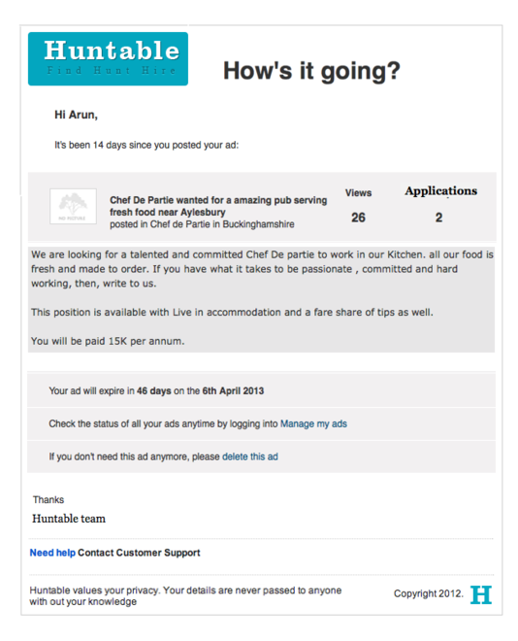
21 After 20 days of job posting, email alert to be sent to the job poster about the status of the job.
FINAL EMAIL TEMPLATE
WILL BE PROVIDED

Slide 41
22 Skill, Industry, Level - entered in the edit profile, to be displayed in both Text CV & Visual CV.
DESIGN WILL BE PROVIDED.

Slide 42
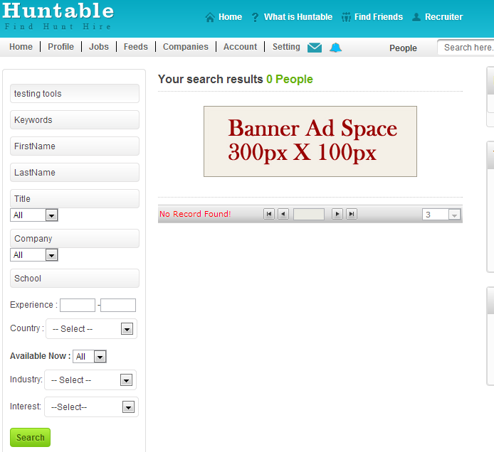
23 All the skill entered by the user to be able to be searchable in the people search

Slide 43
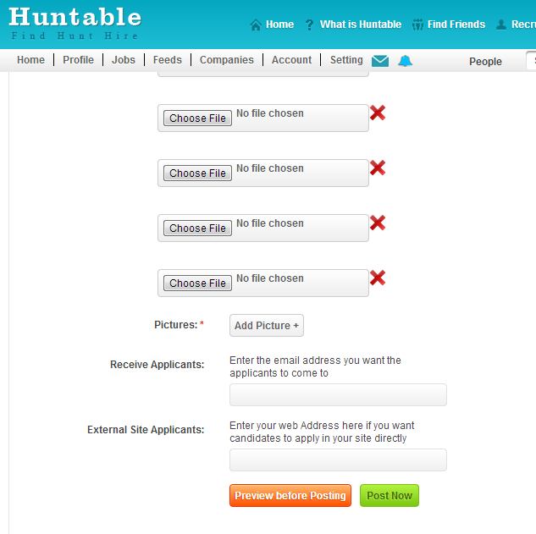
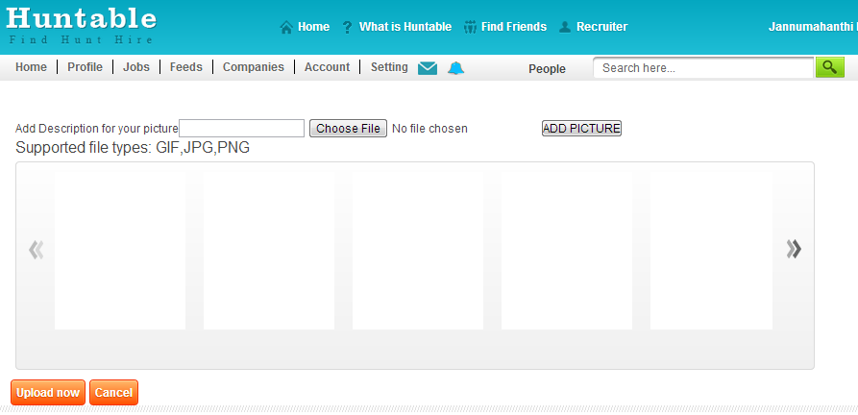
24 POST JOB AVAILABILITY - when added the picture, the added image to look similar to the one when we are adding pictures or videos DESIGN WILL BE PROVIDED
We have a button Add Pictures in the job post page which on click is being navigated to profile picture upload page that button should work as in the Main Menu → Accounts → Profile → My Pictures

Slide 44
26 People you may follow - The mutual followers of your following should be displayed
AA
X
A
B
Y
C
The mutual follower of X and Y : B
Should be suggested as people you
May follow to AA
Pages to be displyed in:
http://huntable.co.uk/HomePageAfterLoggingin.aspx
http://huntable.co.uk/InviteFriends.aspx
(Find followers) if company or recruiters login in
http://huntable.co.uk/Customize-User.aspx
http://huntable.co.uk/Followers.aspx/
http://huntable.co.uk/Following.aspx/
http://huntable.co.uk/InvitationsReport.aspx
http://huntable.co.uk/InvitationsOverview.aspx same as that of invitation report on the right hand side of the sheet
DESIGN WILL BE PROVIDED.

Slide 45
27 In the home page before login we should be able to search a company
Any visitor can search any companies registered in Huntable fro home page.
A non-registered user can not do the following:
Follow the company
Send message to the company
Follow employees of the company
Can’t like or comment on the feeds-Employee activities and business activities/ Products and services/ Pictures/ Articles
Can’t apply for a job from the careers page
Can’t chat as well.
If non-registered user performs above operation this message “You are not logged in. Please login.” should be provided
DESIGN WILL BE PROVIDED

Slide 46
28 When company is sending an invitation
While sending an invitation we should send it as “Follow Company” not as “Join Huntable”
EMAIL TEMPLATE WILL BE PROVIDED
Clicking on the email - Follow company should be redirected to the company home page(so the user can follow the company)
Find Followers
http://huntable.co.uk/InviteFriends.aspx
Invitations can be sent by company through:
Email invitation(Hotmail - Yahoo - Gmail),
Facebook,
Twitter and
LinkedIn

Slide 47
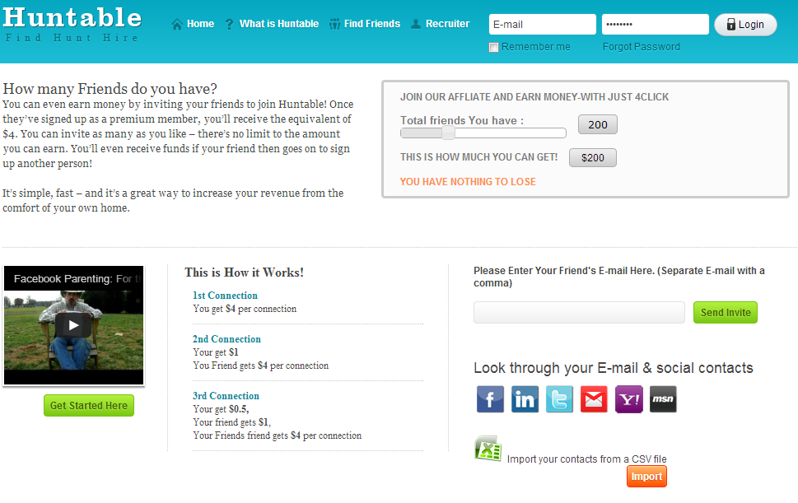
29 Find friends option for company login should be changed to the find followers. 30 Find friends option for RECRUITERS login should be changed to the find followers.
DESIGN WILL BE PROVIDED

Slide 48
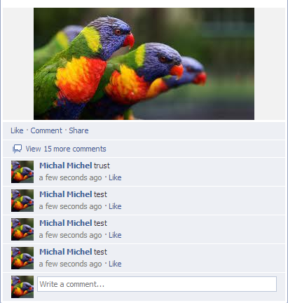
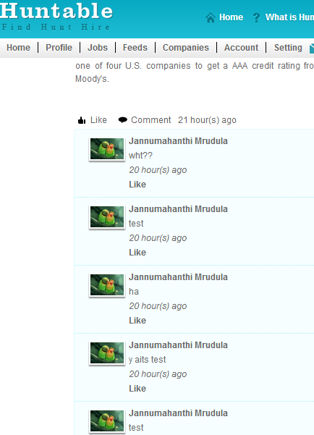
31 By Default 3 comments should be visible for a feed & give a link for the rest as “show more”
By default last three “3” comments should be visible to the user and add an option to show more comments when clicked on show more.
On clicking view more all the rest of the comments should be made visible
User:
http://huntable.co.uk/HomePageAfterLoggingIn.aspx
http://huntable.co.uk/visualcvactivity.aspx
http://huntable.co.uk/businessactivity.aspx
http://huntable.co.uk/employeeactivity.aspx

Slide 49
EMAIL ALERT: WHEN A JOB IS POSTED AND IT MATCHES THE USERS CUSTOMIZED VALUES an email should be sent to the user ABOUT THE JOB DETAILS
EMAIL TEMPLATE WILL BE PROVIDED

Slide 50
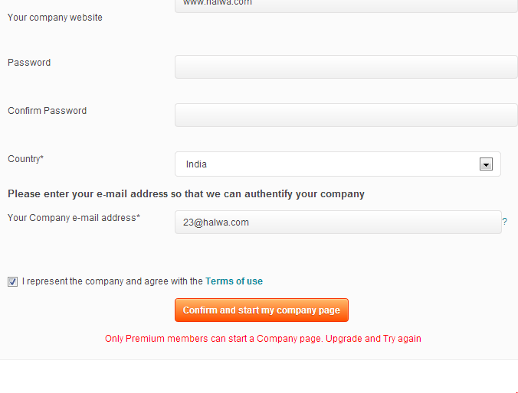
32 Free user can start a company

Slide 51
33 companies s& recruiters can - get a 10 job postings for FREE
In the job posting page - add a tab - 10 FREE jobs.
Activated only once for companies , recruiters & users.
i.e. after using these 10 free jobs - they have to purchase job packages.
DESIGN WILL BE PROVIDED.

Slide 52
34 Photo resolution reducing
Any uploaded pictures to be automatically reduced to a standard size.
SRI MENTIONED 1000px AS STANDARD LETS TRY THIS IF NOT LETS INCREASE OR DECREASE LATER.

Slide 53
35 Google advertisement - place to be replaced with our own advertisement
2 gif advertisement files will be provided
Basic user to have one advertisement
Premium user to have another advertisement
http://huntable.co.uk/UserEmailNotification.aspx
http://huntable.co.uk/Followers.aspx
http://huntable.co.uk/Following.aspx
http://huntable.co.uk/JobApplicants.aspx
http://huntable.co.uk/Applicants.aspx
http://huntable.co.uk/JobsApplied.aspx
http://huntable.co.uk/companiessize.aspx
http://huntable.co.uk/companyview.aspx
http://huntable.co.uk/Likes.aspx
http://huntable.co.uk/SeeMoreRecruiter.aspx
http://huntable.co.uk/videos.aspx
http://huntable.co.uk/pictures.aspx
http://huntable.co.uk/Followers.aspx
http://huntable.co.uk/videos.aspx
http://huntable.co.uk/pictures.aspx
http://huntable.co.uk/companies.aspx
http://huntable.co.uk/MessageInbox.aspx
http://huntable.co.uk/MessageRead.aspx

Slide 54
36 Chat software

Slide 55
37 PAY PAL

Slide 56
38 view all and refresh for People you may follow
DESIGN WILL BE PROVIDED.

Slide 57
39 VAT 20% to be included in secure checkout page
In small letters mention vat at 20% included
The amount should be actual amount + vat 20%

